Slide 1


Workshop on Hands-on Deep Learning Coding and Code Management
Organized by
Center for Computational & Data Sciences, IUB
Day 1

Slide 2
Who we are?
Dr. AKM Mahbubur Rahman
Associate Professor, Director Data Science wing
Research Assistants
Md Fahim Moshiur
Mir Sazzat Hossain Iftee
Jahir Sadik Monon Fahim Ahmed
Armun Alam Dehan

Slide 3
Why we are here?
Get introduced to deep learning programming
Practice programming
Develop deep learning models
Training and fine tuning deep learning models
Hands on experiment design and result analysis
Guidelines for standard coding practice for deep learning

Slide 4
Preferred skills
Python basics with numpy
Finished Numerical Methods course
Linear Algebra with vector notations
Matplotlib, pyplot for visualization
AI, ML, Data Mining courses

Slide 5
Day 1
Image Classification Task
With a custom CNN, CIFAR10
Use of pretrained VGG 16
Babysitting your CNNs
Natural Language Processing Tasks (Emotion recognition from sentences) using
LSTM
Transformer (BERT)

Slide 6
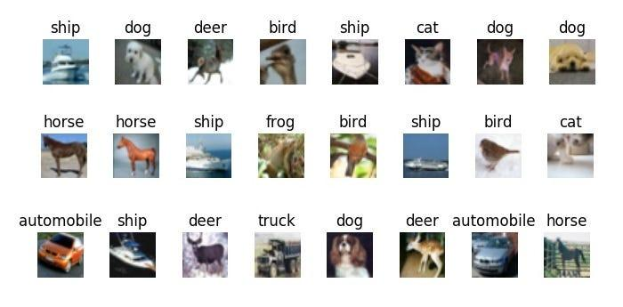
Visual Recognition
Image Classification
Disclaimer: Some slides are modified and adopted from CSE231n (CS231n: Deep Learning for Computer Vision) , Stanford University

Slide 7
Visual Recognition
Image Classification

Slide 8
Visual Recognition
Image Classification

Slide 9
Visual Recognition
Image Classification

Slide 10
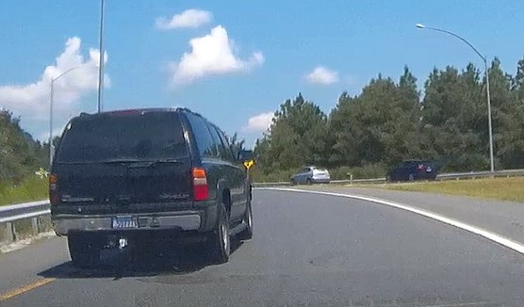
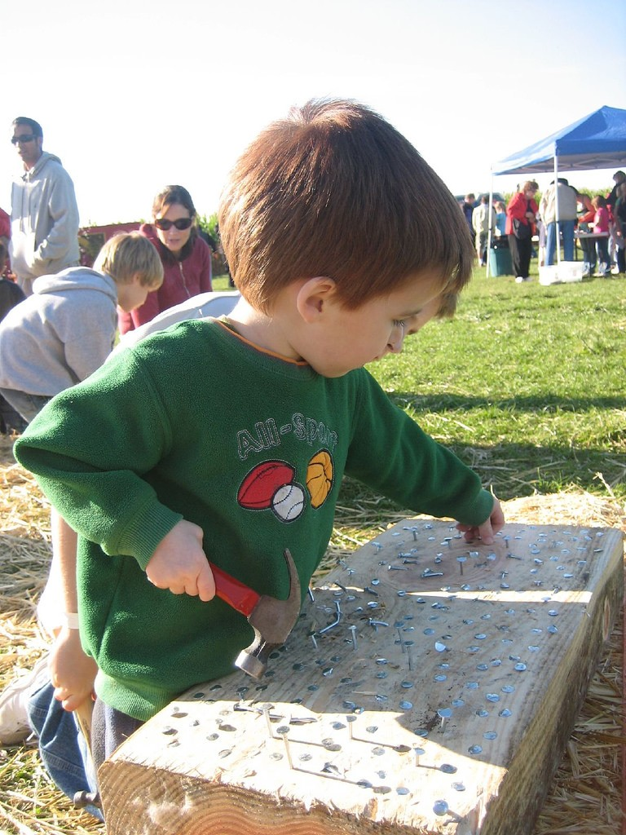
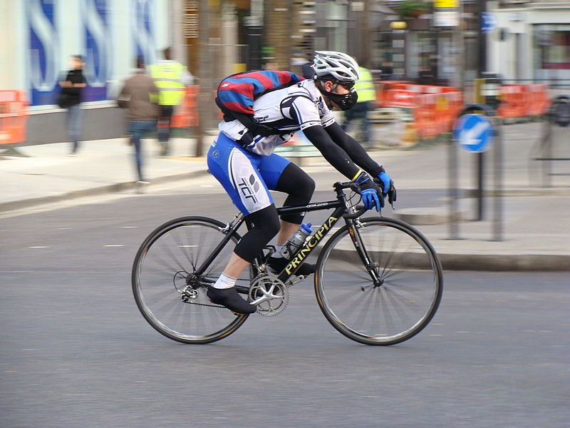


Object detection
Action classification
Image captioning
This image is licensed under CC BY-NC-SA 2.0; changes made
Person on Bike
Person
Hammer
Person
Bike
This image is licensed under CC BY-SA 2.0; changes made
This image is licensed under CC BY-SA 3.0; changes made

Slide 11
Image Classification pipeline

Slide 12
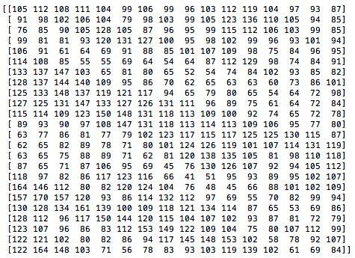
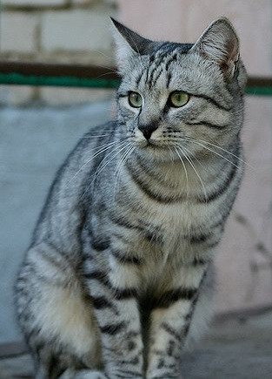
The Problem: Semantic Gap
What the computer sees
An image is just a big grid of numbers between [0, 255]:
e.g. 800 x 600 x 3 (3 channels RGB)
This image by Nikita is licensed under CC-BY 2.0

Slide 13
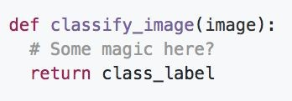
An image classifier
Unlike e.g. sorting a list of numbers
classify_image function should have some magic

Slide 14
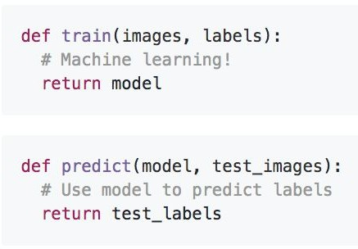
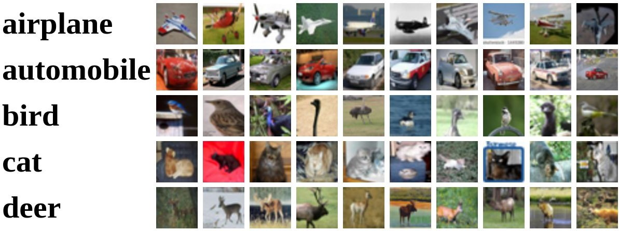
Machine Learning: Data-Driven Approach
Collect a dataset of images and labels
Use Machine Learning to train a classifier
Evaluate the classifier on new images
Example training set

Slide 15
First classifier: Nearest Neighbor
Memorize all data and labels
Predict the label of the most similar training image

Slide 16
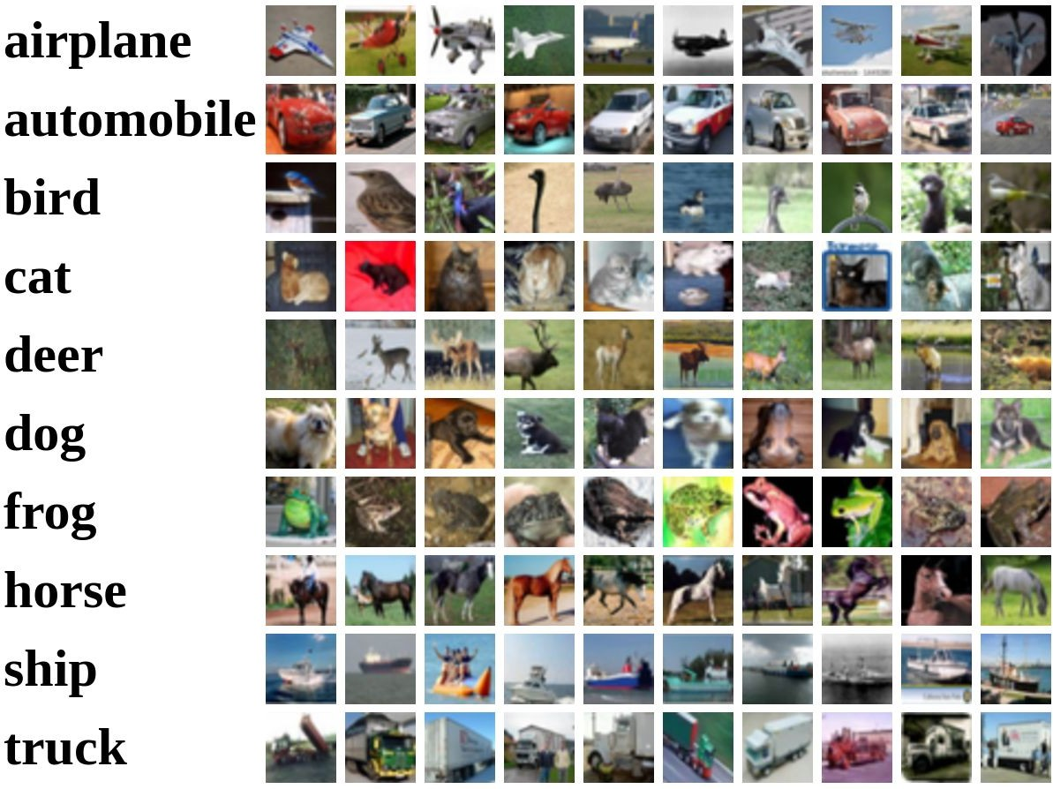
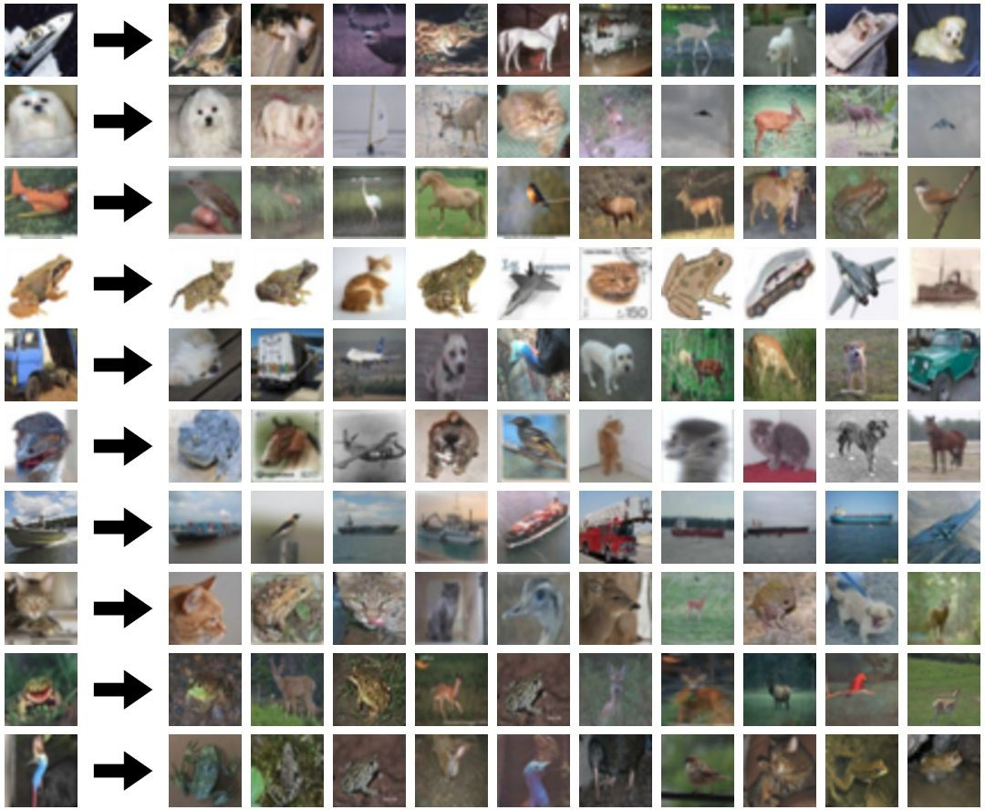
Example Dataset: CIFAR10
10 classes
50,000 training images
10,000 testing images
Test images and nearest neighbors
Alex Krizhevsky, “Learning Multiple Layers of Features from Tiny Images”, Technical Report, 2009.

Slide 17
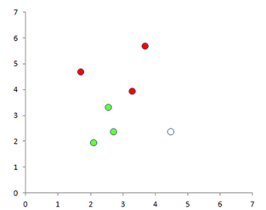
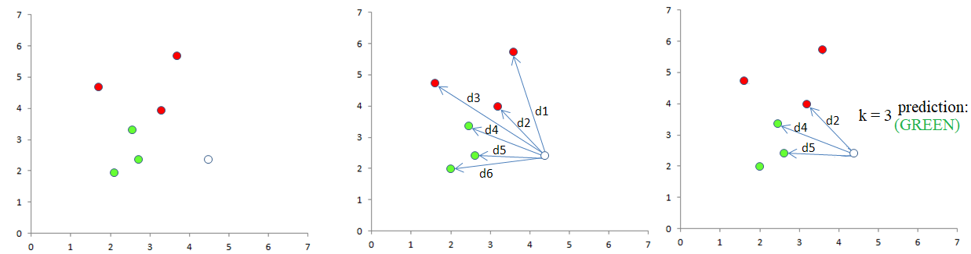
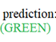
Nearest Neighbor classifier
for two dimensional data

Slide 18
Nearest Neighbor classifier
for two dimensional data

Slide 19
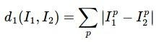
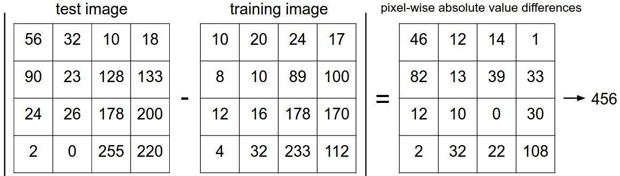
Distance Metric to compare images
L1 distance:
add
We generally use L2 distance as distance metric
Lecture 2 -

Slide 20
Build nearest neighbor classifier
in numpy
Make a copy of the python notebook file in your Google Colab editor

Slide 21
TO DO
Write code to print the predicted labels for first 15 validation images using the nearest_neighbor() function.

Slide 22
K - Nearest Neighbors classifier
for two dimensional data

Slide 23
TO DO
Write code snippet to calculate the predicted label based on k nearest neighbors.
first 15 validation images using the k_nearest_neighbor() function.
See the difference

Slide 24
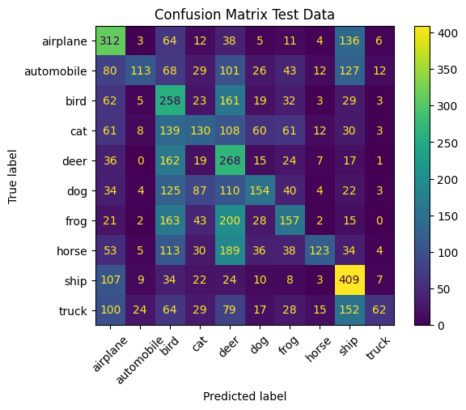
Evaluation in Test images

Slide 25
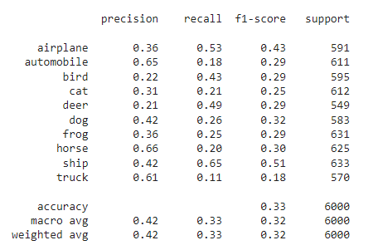
Evaluation in Test images

Slide 26
Finally ..
Putting everything together in OOP structure (class, methods)

Slide 27
KNN is not good at all….
Lecture 2 -

Slide 28
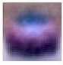
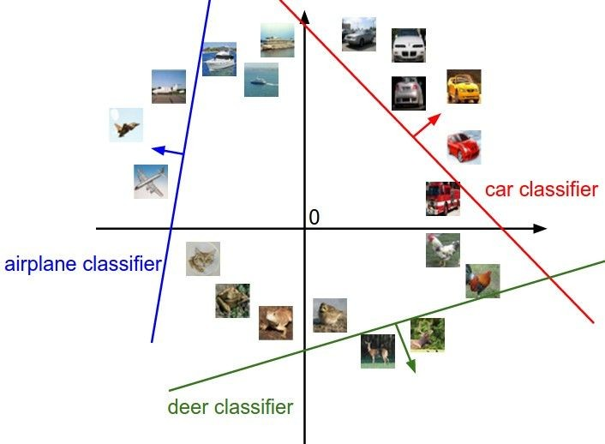
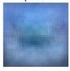
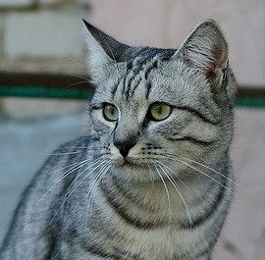
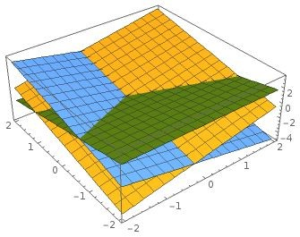
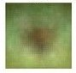
Linear Classification
f(x,W) = Wx + b
x is an Array of 32x32x3 numbers (3072 numbers total)
W is 10 x 3072
b is 10 x 1

Slide 29
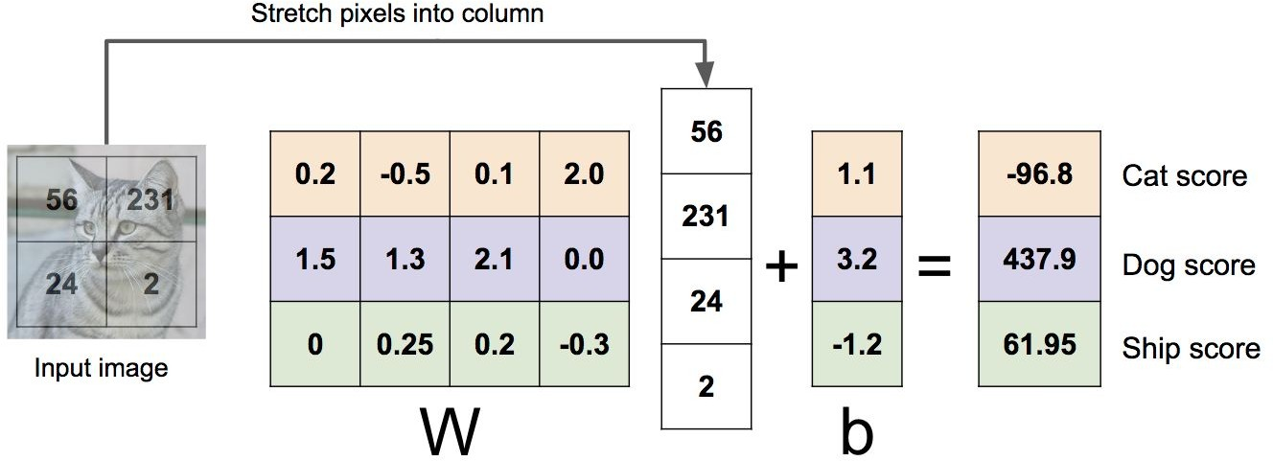
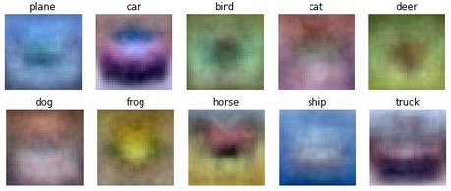
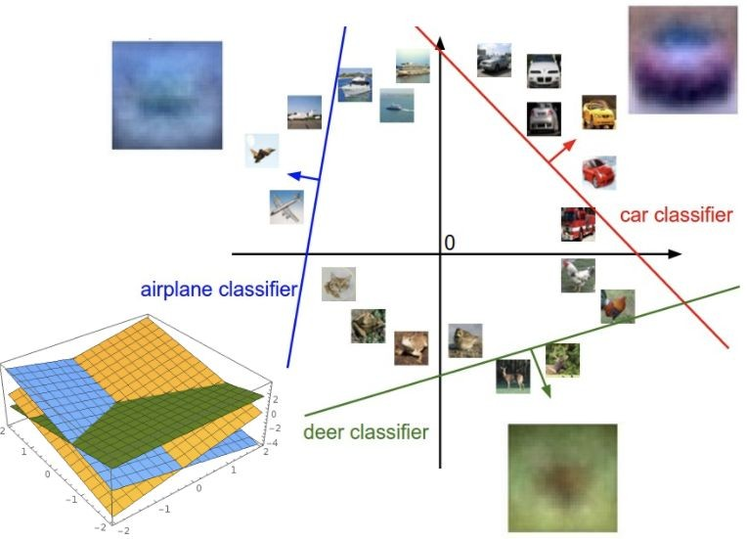
Linear Classifier: Three Viewpoints
Algebraic Viewpoint
Visual Viewpoint
Geometric Viewpoint
f(x,W) = Wx + b
One template per class
Hyperplanes cutting up space
Lecture 2 -

Slide 30
Softmax Classifier
(Multinomial Logistic Regression)
Want to interpret raw classifier scores as probabilities
cat car frog
3.2
5.1
-1.7

Slide 31
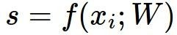
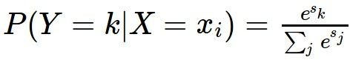
Softmax Classifier
(Multinomial Logistic Regression)
Softmax Function
Want to interpret raw classifier scores as probabilities
cat car frog
3.2
5.1
-1.7

Slide 32
Softmax Classifier
(Multinomial Logistic Regression)
Want to interpret raw classifier scores as probabilities
Softmax Function
Probabilities must be >= 0
cat car frog
3.2
5.1
-1.7
24.5
164.0
0.18
exp
unnormalized probabilities
April 10, 2018

Slide 33
Softmax Classifier
(Multinomial Logistic Regression)
Want to interpret raw classifier scores as probabilities
Softmax Function
Probabilities must be >= 0
Probabilities must sum to 1
cat car frog
3.2
5.1
-1.7
24.5
164.0
0.18
0.13
0.87
0.00
exp
normalize
unnormalized
probabilities
Fei-Fei Li & Justin Johnson & Serena Yeung
probabilities
April 10, 2018

Slide 34
Softmax Classifier
(Multinomial Logistic Regression)
Want to interpret raw classifier scores as probabilities
Softmax Function
Probabilities must be >= 0
Probabilities must sum to 1
cat car frog
3.2
5.1
-1.7
24.5
164.0
0.18
0.13
0.87
0.00
exp
normalize
Unnormalized
unnormalized
probabilities
log-probabilities / logits
probabilities
April 10, 2018

Slide 35
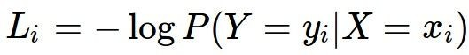
Softmax Classifier
(Multinomial Logistic Regression)
Want to interpret raw classifier scores as probabilities
Softmax Function
Probabilities must be >= 0
Probabilities must sum to 1
cat car frog
3.2
5.1
-1.7
24.5
164.0
0.18
0.13
0.87
0.00
compare
1.00
0.00
0.00
exp
normalize
Unnormalized
log-probabilities / logits
unnormalized
probabilities
probabilities
Correct
probs
April 10, 2018

Slide 36
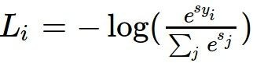
Softmax Classifier
(Multinomial Logistic Regression)
Want to interpret raw classifier scores as probabilities
Softmax Function
cat car frog
3.2
5.1
-1.7
Maximize probability of correct class
Putting it all together:

Slide 37
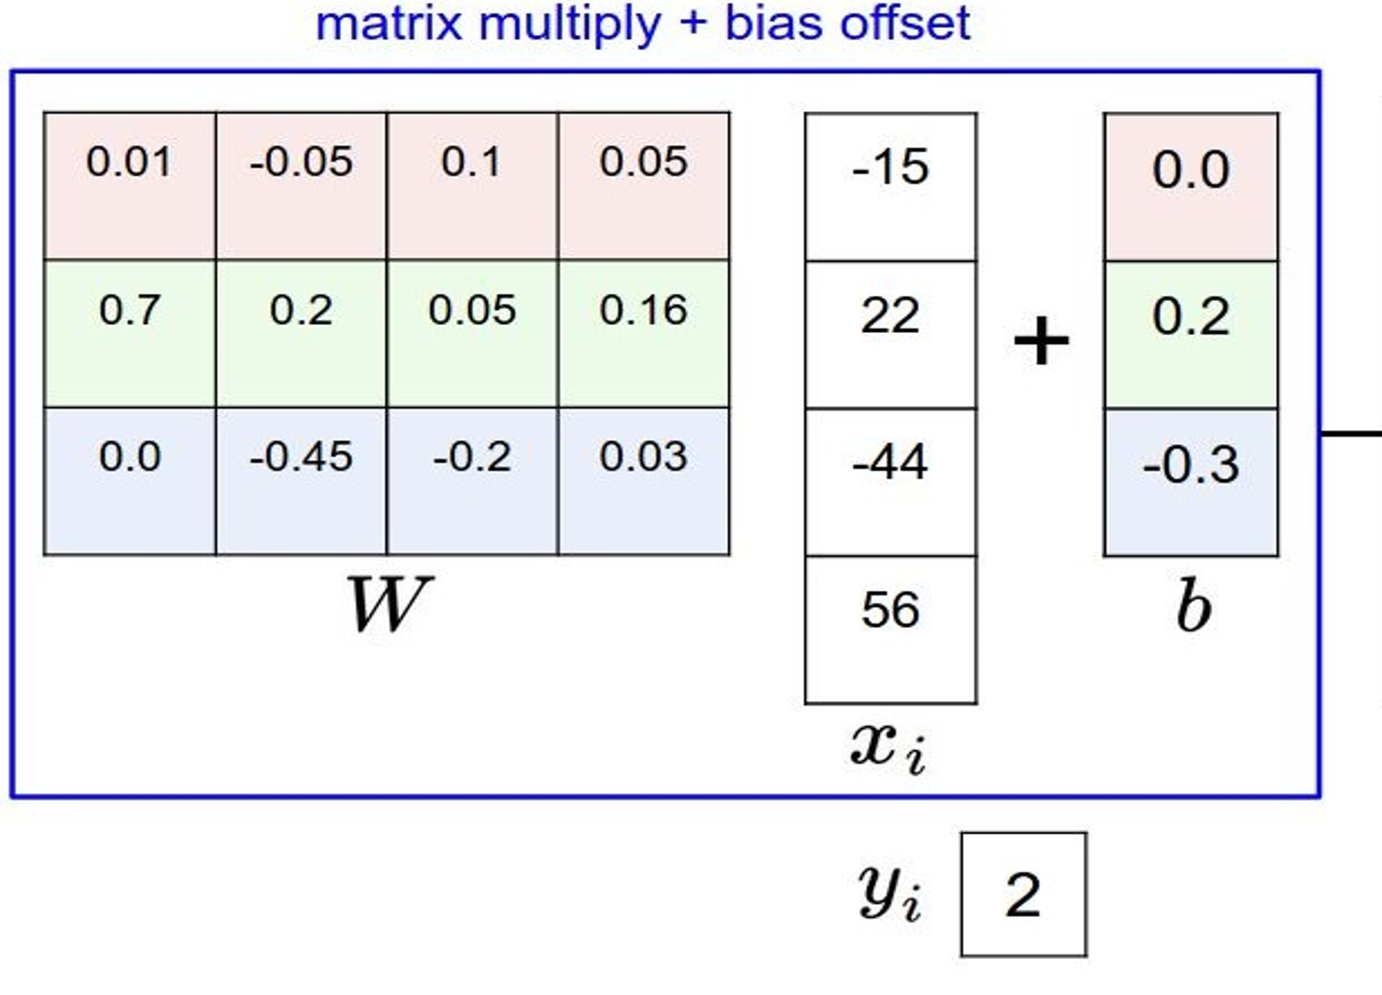
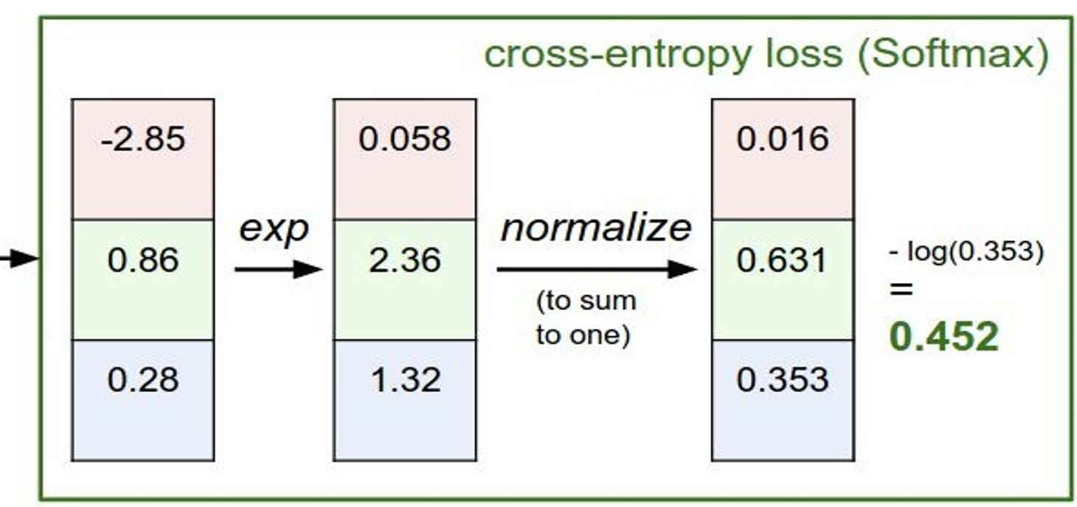
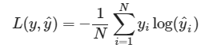
Whole Picture & CE Loss Calculation
Total loss:

Slide 38
Optimization
Find the W and b that will give the total loss minimum.
How?
April 10, 2018

Slide 39
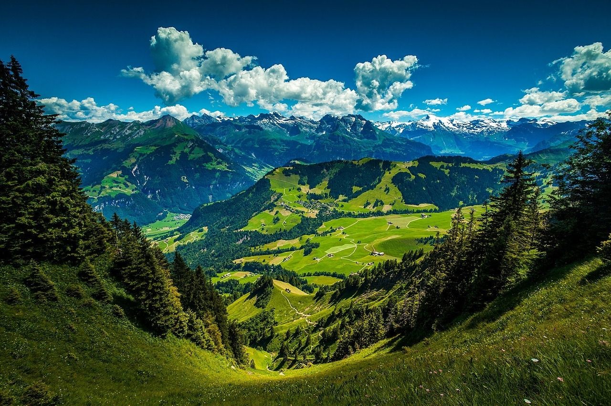

Follow the slope
Gradient Descent
April 10, 2018

Slide 40
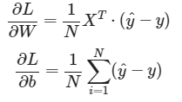
Gradient Calculation

Slide 41
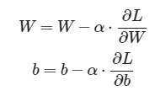
Parameter updates

Slide 42
Training Procedure
(Learning the parameters)
Mini-batch Stochastic Gradient Descent (SGD) Loop:
Sample a batch of data
Forward propagate it through the network
Calculate loss
Backprop to calculate the gradients
Update the parameters using the gradient

Slide 43
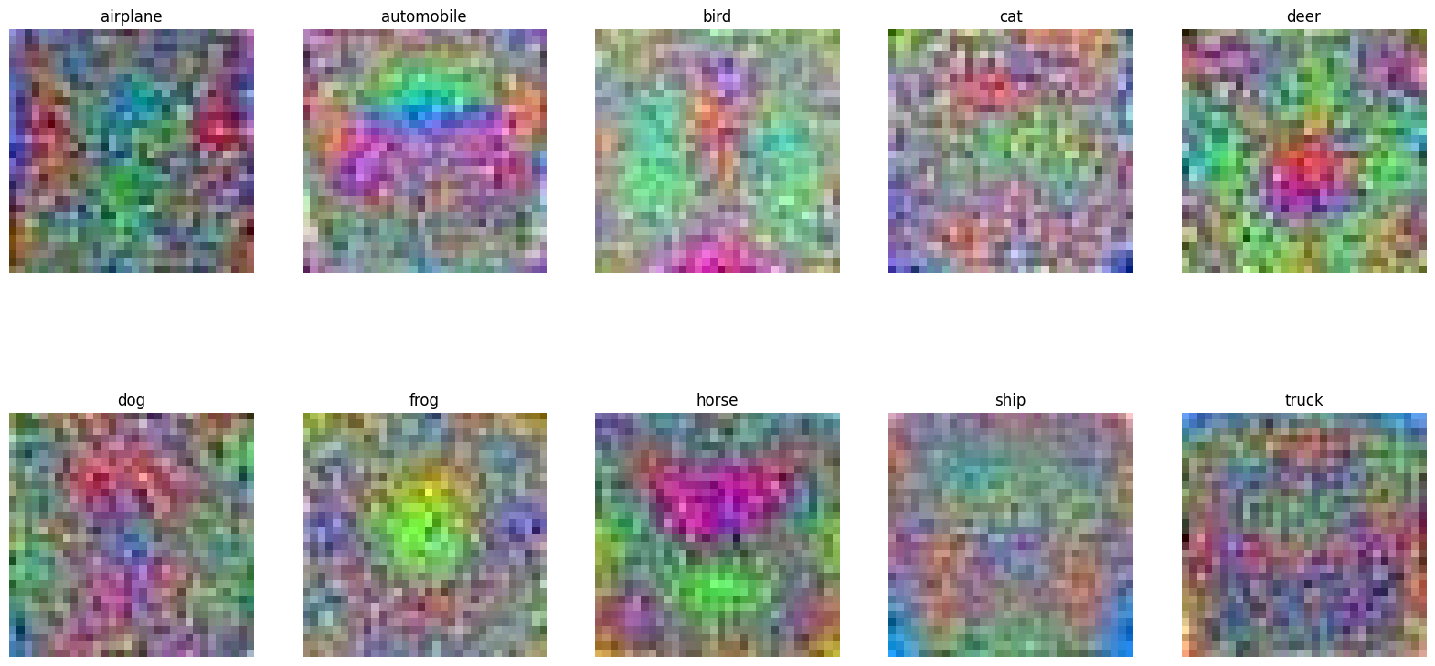
Visualize the weights

Slide 44
TODO
Change the following hyper parameter for better average f1 score
Epoch size: 100
Batch size: 64, 128, 256, 512
Learning rate: 0.05, 0.001, 0.005
Visualize the weights now. Are you seeing some patterns in the weights? If so, your weights are perfectly learned.

Slide 45
Day 1, Session 1
Convolutional Neural Network

Slide 46
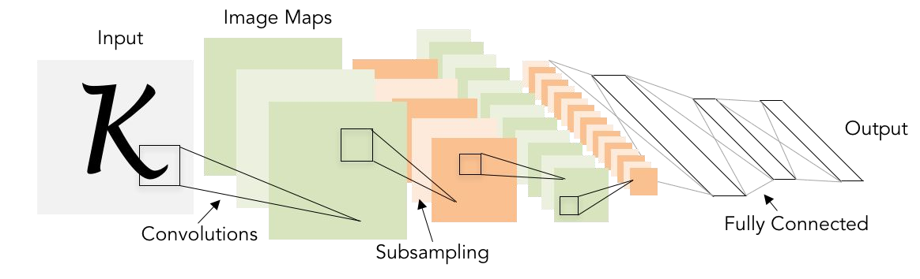
Big Picture
Illustration of LeCun et al. 1998 from CS231n 2017 Lecture 1

Slide 47
Convolution Layer
32x32x3 image -> preserve spatial structure
32
height
32
depth
width
3

Slide 48
Convolution Layer
32x32x3 image
5x5x3 filter
32
Convolve the filter with the image
i.e. “slide over the image spatially, computing dot products”
32
3

Slide 49
Convolution Layer
Filters always extend the full depth of the input volume
32x32x3 image
5x5x3 filter
32
Convolve the filter with the image
i.e. “slide over the image spatially, computing dot products”
32
3

Slide 50
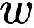
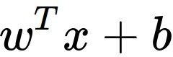
Convolution Layer
32x32x3 image 5x5x3 filter
32
1 number:
the result of taking a dot product between the filter and a small 5x5x3 chunk of the image
(i.e. 5*5*3 = 75-dimensional dot product + bias)
32
3

Slide 51
Convolution Layer
consider a second, green filter
32x32x3 image 5x5x3 filter
activation maps
32
28
convolve (slide) over all spatial locations
32
28
3
1

Slide 52
Convolution Demo
http://cs231n.github.io/convolutional-networks/#conv

Slide 53
We have six filters
activation maps
32
28
Convolution Layer
32
28
3
6
We stack these up to get a “new image” of size 28x28x6!

Slide 54
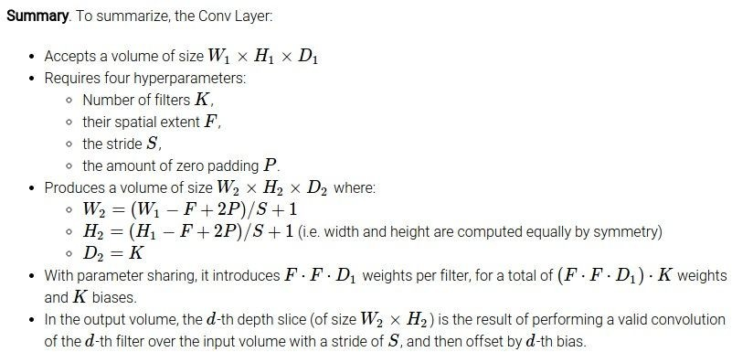
Summary of convolutional layer

Slide 55
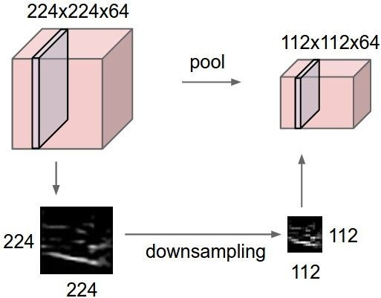
Sub-sampling/Pooling Layer
makes the representations smaller and more manageable
operates over each activation map independently:

Slide 56
Max Pooling
Single depth slice
1 | 1 | 2 | 4
5 | 6 | 7 | 8
3 | 2 | 1 | 0
1 | 2 | 3 | 4
x
max pool with 2x2 filters and stride 2
6 | 8
3 | 4
y

Slide 57
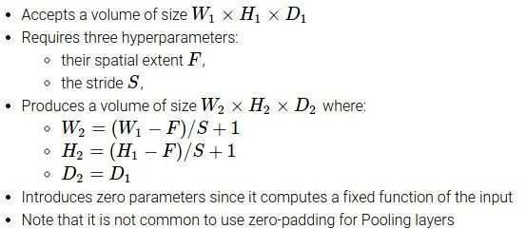
Summary of maxpool layer
Common settings:
F = 2, S = 2
F = 3, S = 2

Slide 58
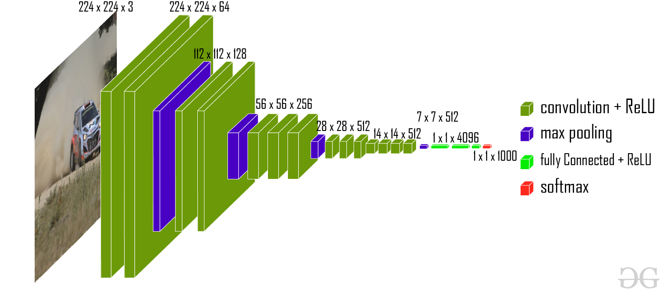
VGG 16
Sigmoid

Slide 59
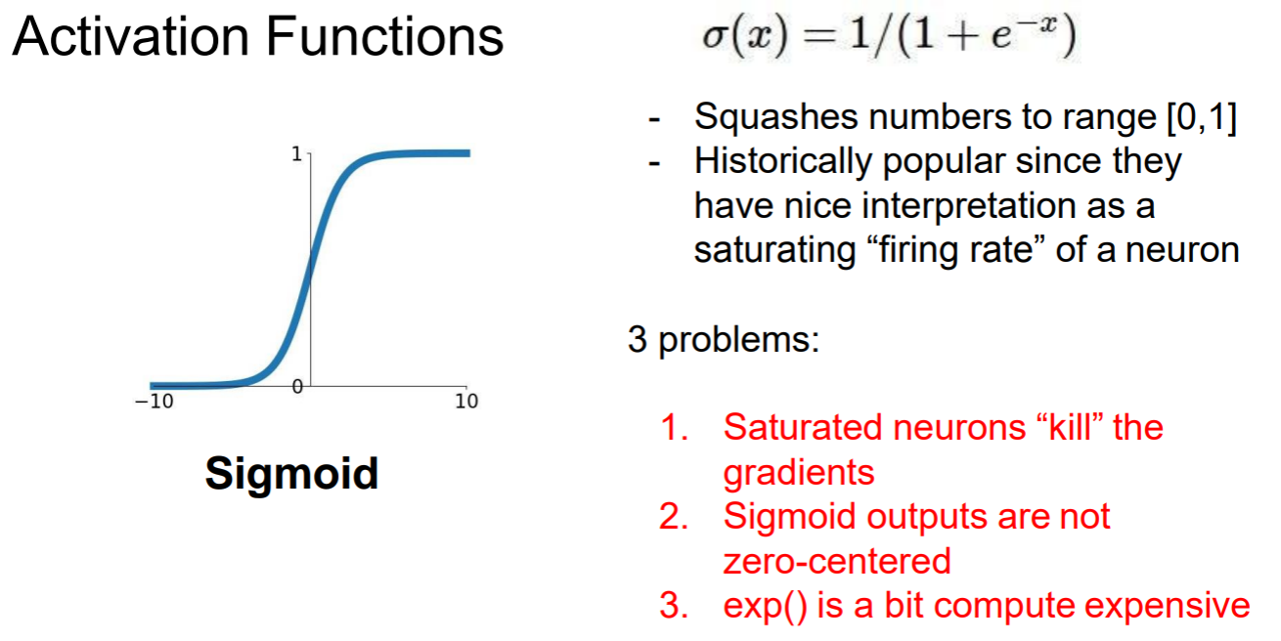
Sigmoid

Slide 60
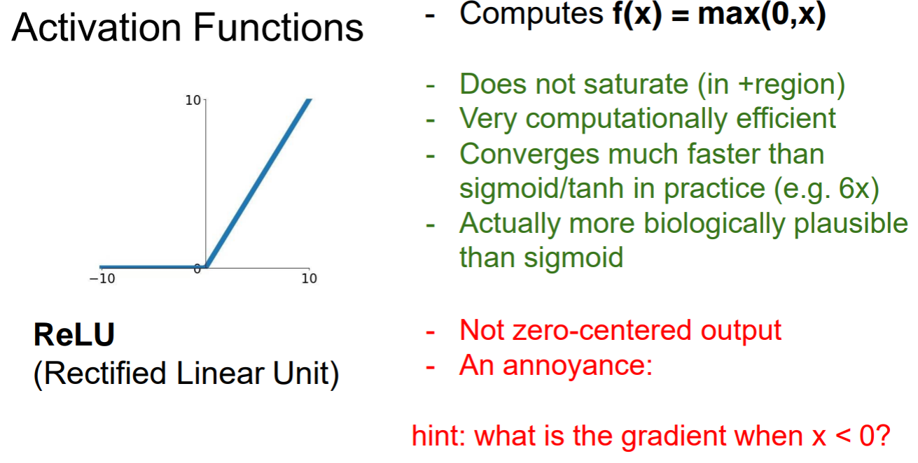
ReLu Activation Function

Slide 61

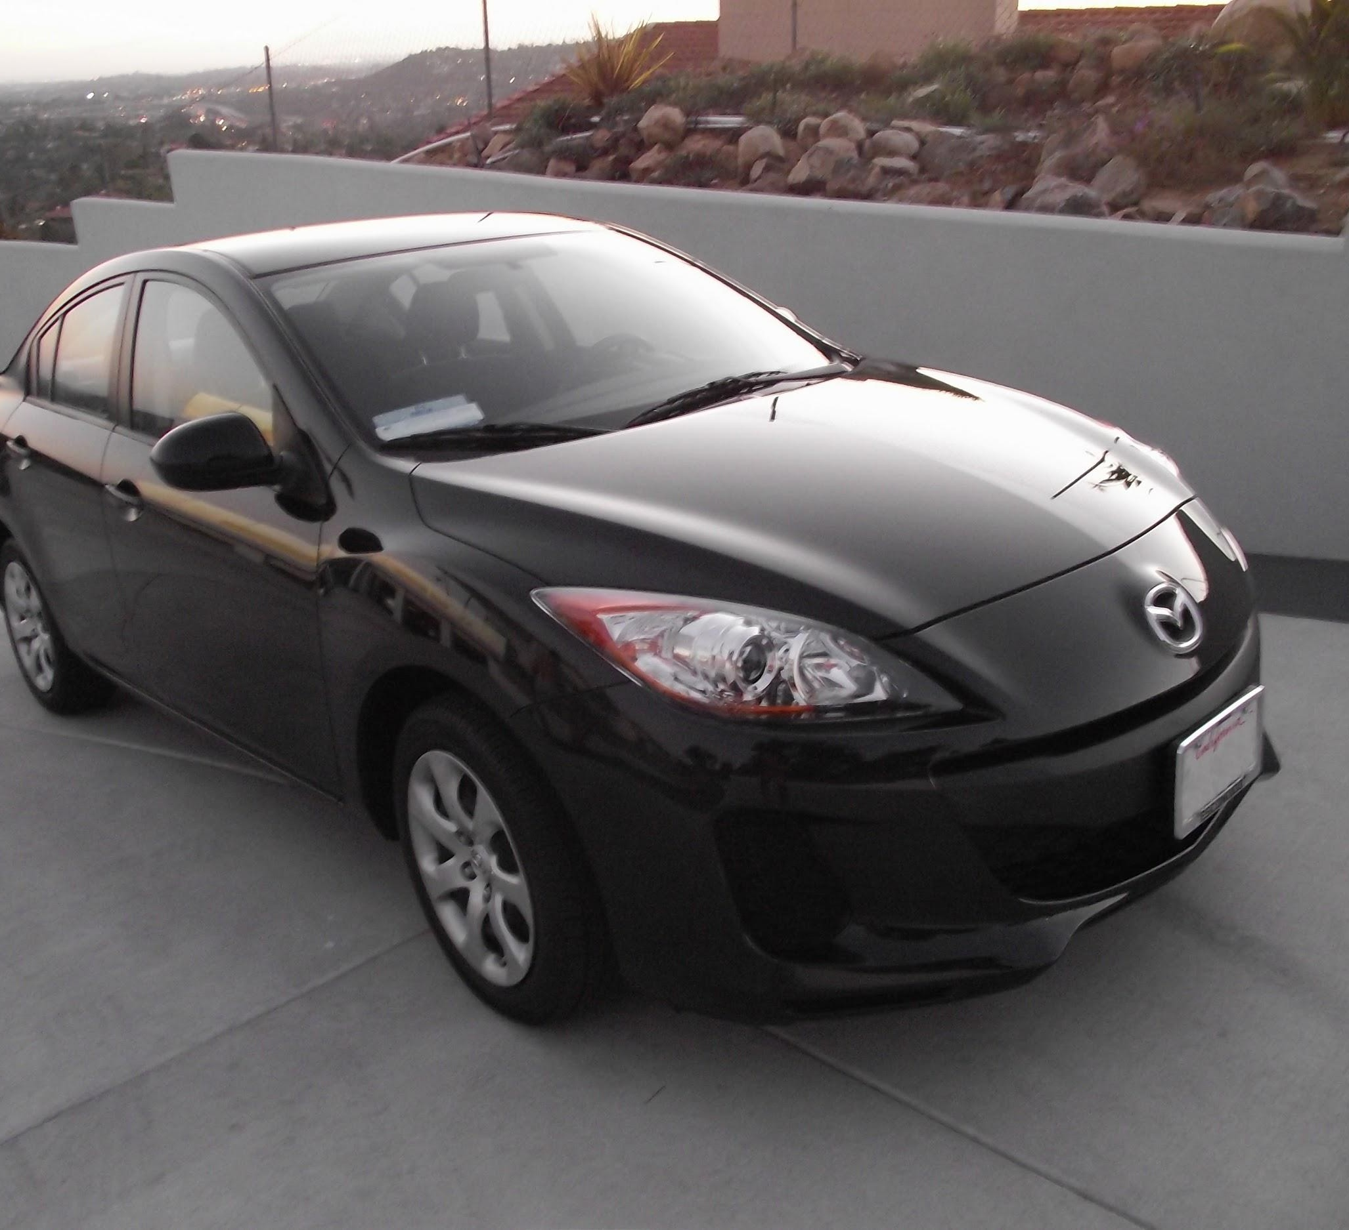
Fully Connected Layer (FC layer)
- Contains neurons that connect to the entire input volume, as in ordinary Neural Networks
Demo: http://cs231n.stanford.edu/

Slide 62
Developing your CNN
for image classification
Conv layer, Relu
Conv layer, Relu
Max pool
Conv layer, Relu
Conv layer, Relu
Max pool
Flatten
FC1, Relu
FC2, Relu
FC3, Relu
Softmax

Slide 63
TODO Task 1
Senior RAs will guide you through the CNN codes for above architecture
Run your code
Produce the train and validation loss curves
Test and produce your confusion matrix and evaluation metrics

Slide 64
Babysitting your CNN

Slide 65
Training Process
Mini-batch Stochastic Gradient Decent :
Sample a batch of data
Forward prop it through the graph (network)
Calculate loss
Backprop to calculate the gradients
Update the parameters using the gradient

Slide 66
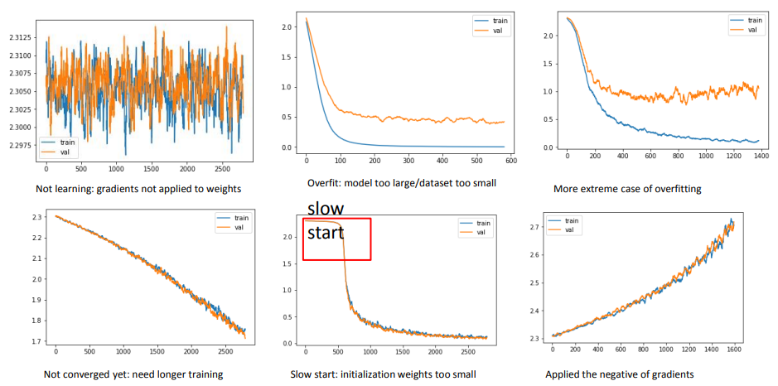
Loss curve investigation

Slide 67
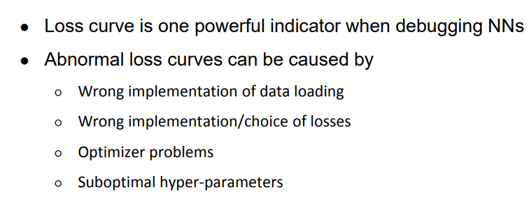
Loss curve investigation

Slide 68

Normalize your Data

Slide 69

Batch Normalization

Slide 70

Batch Normalization

Slide 71

Batch Normalization

Slide 72

Batch Normalization

Slide 73
TODO Task 2
Generally, fully connected layers are followed by sigmoid function. Add sigmoid activation function after each linear layer. Remove the Relu function for linear layers (architecture 2)
Run your code
Produce the train and validation loss curves
Test and produce your confusion matrix and evaluation metrics
Add one convolution layer and Relu layer just before the flattening (architecture 3)
Run your code
Produce the train and validation loss curves
Test and produce your confusion matrix and evaluation metrics
Add batch normalizations in the first two FC layers before sigmoid activation function (architecture 4)
For each of the fc layers (just before the sigmoid)
Run your code
Produce the train and validation loss curves
Test and produce your confusion matrix and evaluation metrics

Slide 74
TODO Task 3
Create a table to compare your results for four architecture
Original CNN (architecture 1)
CNN with sigmoid (architecture 2)
CNN with sigmoid and one extra conv + relu layer (architecture 3)
Architecture 3 With BN layers (architecture 4)

Slide 75
Weight Initialization
Random Initialization
Xavier Initialization [Glorot et al., 2010]
- Reasonable initialization

Slide 76

Random Initialization

Slide 77

Xavier Initialization

Slide 78

Learning rate decay

Slide 79

Learning rate decay

Slide 80

Learning Rate Decay: Linear Warmup
Goyal et al, “Accurate, Large Minibatch SGD: Training ImageNet in 1 Hour”, arXiv 2017

Slide 81

Regularization: Add term to loss

Slide 82

Regularization: Dropout

Slide 83

Regularization: Dropout

Slide 84

Data Augmentation

Slide 85



Data Augmentation

Slide 86
Choosing Hyper parameter
Step 1: Check initial loss
Step 2: Overfit a small sample
Step 3: Find LR that makes loss go down Use the architecture from the previous step, use all training data, turn on small weight decay, find a learning rate that makes the loss drop significantly within ~100 iterations
Good learning rates to try: 1e-1, 1e-2, 1e-3, 1e-4

Slide 87

Hyper-parameter Tuning

Slide 88
TODO Task 4
Take the best performing architecture from the last task
Add dropout in the first two FC layers after the activation functions (probability: 0.5
Initialize your weight with Xavier
Hyper parameter options:
Batch Size: 256, 512, 1024
Learning Rate: 0.0001, 0.001
Learning rate scheduler: Linear, Cosine, sqrt
Run training
Produce the train and validation loss curves
Test and produce your confusion matrix and evaluation metrics

Slide 89
CIFAR10 Image classification
using pretrained VGG16
VGG 16 weights are trained in Image nets
We will finetune the weights for CIFAR10
Performance Evaluation

Slide 90
Text Processing (NLP)
Downstream tasks:
Emotion recognition from sentences
Sentiment analysis from reviews
Automatic Essay grading
Question Answering AI bot (Chat GPT, Gemini, Claude)

Slide 91

How to represent a sentence

Slide 92
Bag-of-Words representation
Term as the basis for vector space
Doc1: Text mining is to identify useful information.
Doc2: Useful information is mined from text.
Doc3: Apple is delicious.
 | text | information | identify | mining | mined | is | useful | to | from | apple | delicious
Doc1 | 1 | 1 | 1 | 1 | 0 | 1 | 1 | 1 | 0 | 0 | 0
Doc2 | 1 | 1 | 0 | 0 | 1 | 1 | 1 | 0 | 1 | 0 | 0
Doc3 | 0 | 0 | 0 | 0 | 0 | 1 | 0 | 0 | 0 | 1 | 1

Slide 93
How to define a good similarity metric?
Euclidean distance?
information
D₂
D₄
D₃
text
D₆
D₅
D₁
identify

Slide 94


Similarity measurement

Slide 95
Tokenization
Break a stream of text into meaningful units
Tokens: words, phrases, symbols
Definition depends on language, corpus, or even context
Input: It’s not straight-forward to perform so-called “tokenization.”
Output(1): 'It’s', 'not', 'straight-forward', 'to', 'perform', 'so-called', '“tokenization.”'
Output(2): 'It', '’', 's', 'not', 'straight', '-', 'forward, 'to', 'perform', 'so', '-', 'called', ‘“', 'tokenization', '.', '”‘

Slide 96
Stemming
Reduce inflected or derived words to their root form
Plurals, adverbs, inflected word forms
E.g., ladies -> lady, referring -> refer, forgotten -> forget
Bridge the vocabulary gap
Solutions (for English)
Porter stemmer: patterns of vowel-consonant sequence
Krovetz stemmer: morphological rules
Risk: lose precise meaning of the word
E.g., lay -> lie (a false statement? or be in a horizontal position?)

Slide 97
Stopwords
Useless words for document analysis
Not all words are informative
Remove such words to reduce vocabulary size
No universal definition
Risk: break the original meaning and structure of text
E.g., this is not a good option -> option
to be or not to be -> null

Slide 98

Stopwords

Slide 99
Bag-of-Words representation
 | text | information | identify | mining | mined | is | useful | to | from | apple | delicious
Doc1 | 1 | 1 | 1 | 1 | 0 | 1 | 1 | 1 | 0 | 0 | 0
Doc2 | 1 | 1 | 0 | 0 | 1 | 1 | 1 | 0 | 1 | 0 | 0
Doc3 | 0 | 0 | 0 | 0 | 0 | 1 | 0 | 0 | 0 | 1 | 1
Assumption
Words are independent from each other
Pros
Simple
Cons
Basis vectors are clearly not linearly independent!
Grammar and order are missing

Slide 100
Word Embedding
One Hot
Word Dimension size will increase with vocabulary size
Slow
Words are not orthogonal each other
Word synonyms are orthogonal (not preferred)
Fixed dimension embedding
Built-in torch embedding
Word2vec

Slide 101
Sequential Modeling with LSTM
I am playing cricket.
Am I playing cricket?

Slide 102


Sequential Modeling with LSTM
this
product
is
awesome
FC Layers
Emotion class probability score

Slide 103
Text Processing with one-hot encoding

Slide 104
Text Processing with built-in torch embedding

Slide 105
TODO Task 5
Use word2vec for word embedding for your LSTM based emotion recognition model
word2vec library is already downloaded into your runtime memory
Show confusion matrix, average F1 measure, Compare your performance with torch embedding

Slide 106
Contextual Embedding

Slide 107
Contextual Embeddings
The animal didn't cross the road because it
What should be the properties of "it"?
The animal didn't cross the road because it was too tired
The animal didn't cross the road because it was too wide
At this point in the sentence, it's probably referring to either the chicken or the street
Notes:
But the static meaning of "it" can't represent that, it just means "I am a non-human pronoun".

Slide 108
Intuition of attention: (Self-Attention)
Columns corresponding to input tokens
Columns corresponding to input tokens
Attention helps capture the context better and in a much more “global” manner
“Global”: Long ranges captures and in both directions (previous and ahead)
The input sequence but differing in the last word (tired -> wide)
An input sequence
Layer k+1
How much the word “it” is being “attended to” by other words in the input sequence
Note how the attention has changed
Layer k
Example credit: https://blog.research.google/2017/08/transformer-novel-neural-network.html

Slide 109
Attention is left-to-right (a simpler view)

Slide 110
Simplified version of attention: a sum of prior words weighted by their similarity with the current word
Given a sequence of token embeddings:
x₁ x₂ x₃ x₄ x₅ x₆ x₇ x_{i}
Produce: a_{i} = a weighted sum of x₁ through x₇ (and x_{i})
Weighted by their similarity to x_{i}
Notes:
D

Slide 111
Attention intuition
query
x1 x2 x3 x4 x5 x6 x7 xi
values
Notes:
D

Slide 112
Attention intuition
query
x1 x2 x3 x4 x5 x6 x7 xi
keys
k
k
k
k
k
k
k
k
values
v
v
v
v
v
v
v
v
Notes:
D

Slide 113
Final equations for one attention head
Notes:
the result of a dot product can be an arbitrarily large (positive or negative) value, and exponentiating large values can lead to numerical issues and loss of gradients during training. To avoid this, we scale the dot product by a factor related to the size of the embeddings, via diving by the square root of the dimensionality of the query and key vectors (dk).

Slide 114
Calculating the value of a3

Slide 115
Position Embedding

Slide 116

If embedding has a dimensionality of 4:
Janet | will | back

Slide 117

Transformer Architecture
Let's consider the embeddings for an individual word from a particular layer for next word prediction
One transformer Block

Slide 118



Popular Transformer Variants: BERT and GPT
118
The standard transformer architecture is an encoder-decoder model
Some models use just the encoder or the decoder of the transformer
BERT (Bidirectional Encoder Representations from Transformers)
Basic BERT can be learned to encoder token sequences
GPT (Generative Pretrained Transformer)
Basic GPT can be used to generate token sequences similar to its training data
Encoder
Decoder
This encoder can be used for other tasks by fine-tuning
Also, no cross-attention since there is no encoder
A transformer which contains only the decoder
A transformer which contains only the encoder
BERT
GPT
Pre-trained using a next token prediction objective
Trained unsupervisedly using a missing token prediction objective
This is just start of sentence token
Missing token which BERT tries to predict

Slide 119

BERT Pretraining
Blog: https://medium.com/@shaikhrayyan123/a-comprehensive-guide-to-understanding-bert-from-beginners-to-advanced-2379699e2b51

Slide 120

Emotion recognition using pretrained BERT
movie

Slide 121
TODO Task 6: Identify the Most Attentive Tokens for Each Class in the Test Dataset
The BERT model computes attention scores for each word in every layer, which influence its predictions.
After training or fine-tuning the BERT model on the Emotion dataset, the model is expected to focus more on content-specific words relevant to the target class.
Your task is to extract the most attentive tokens based on the BERT attention scores.
For instance, in the "Happy" class, the most attentive tokens could be "joyful," "wow," or "pleased."
Detail task description:
https://iubedubd-my.sharepoint.com/:b:/g/personal/akmmrahman_iub_edu_bd/EciUyZiLg-pHtQ64a32Ox6cB9KlhKOrMyQyCUc18hfay1A?e=BE4UVd

